Slide 1
Review of Planning & Economic Development Department Activities through June 2014
July 22, 2014
“To serve the Hualapai people by developing the Tribe’s human, economic, and natural resources in ways that lead to greater self-sufficiency while protecting the people’s unique heritage, culture, and environment.”
Prepared by the Planning and Economic Development Department, Hualapai Tribe
887 West Highway 66, Peach Springs
(928) 769-1310

Slide 2
Current Projects The Planning and Economic Development Office is working on for the Hualapai Tribe
Master Plan for the Hualapai Tribe
Elder Group Home
New Playgrounds for Peach Springs
Alternative to Corrections/Transitional Living Facility
Adult Detention Center
Youth Camp
Accessibility Improvements to Public Buildings
Grocery Store Remodel
Stabilization of Osterman Service Station
Housing Improvement Program
Home Site Leases
Building Permits
Publish the Gamyu
Future Projects

Slide 3
Master Plan for the Hualapai Tribe
The Master Plan covers all Reservation Lands including Cholla Ranch and Truxton Triangle
The Master Plan is divided into nine elements covering:
  Land Use
  Housing
  Public Buildings
  Economic Development
  Infrastructure
  Ranching, Forestry and Mining
  Transportation
  Environmental Protection
  Strategic Planning
Status:
  Nine elements and the introduction have been approved by the Tribal Environmental Review Committee, with highlights published in the Gamyu.
  When all elements have been published, and commented on by the public, a community meeting will be held to discuss the Master Plan and address public comments.

Slide 4
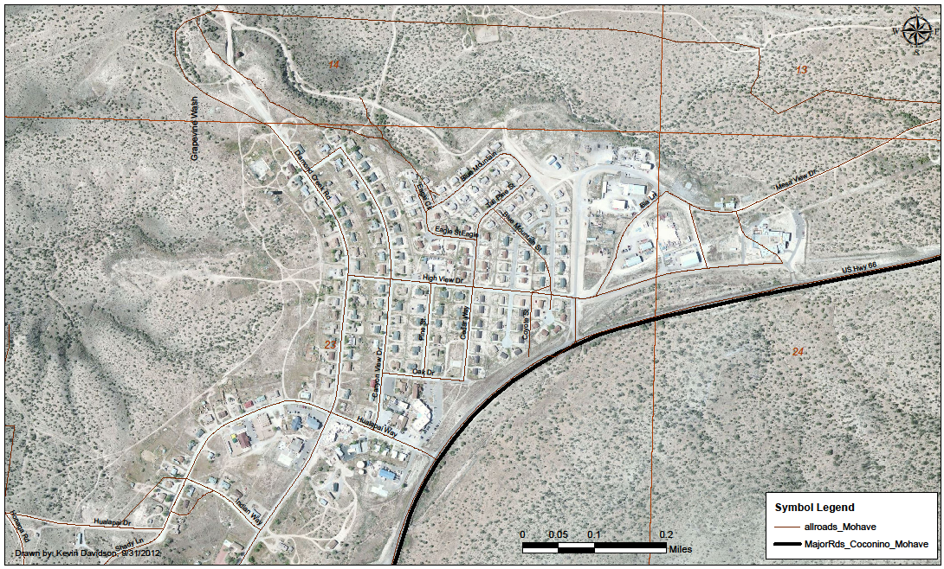
Uptown Peach Springs
Site for Daycare Center
Site for Elder Group Home
Site for Alternative to Corrections

Slide 5
Elder Group Home
Project: A 4,600 sq. ft., 8-bedroom building located at Juniper and Oak Streets (play ground) designed for active seniors. Estimated cost is $1,125,000
Status: Project broke ground on April 21, 2014 and should be completed by Thanksgiving of 2014.
Architect’s rendering of main entrance on east side of building

Slide 6
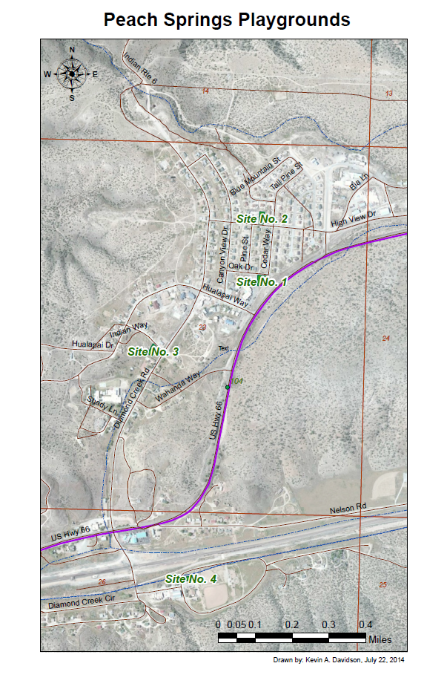
Playgrounds
Project: Provide additional playgrounds in Peach Springs as follows:
  1) new 0.36 acre playground with basketball court accross street from Elder Group Home,
  2) new 0.26 acre playground next to Housing Department,
  3) new 0.30 playground on Indian Way next to Mormon Church, and
  4) expand existing 0.15 acre playground next to Court House.
Budget: $1,225,000.
Status: Project to be funded by 2014 Indian Community Development Block Grant and Tribal matching funds. Award notice expected in late 2014 with design and construction to begin in 2015.

Slide 7
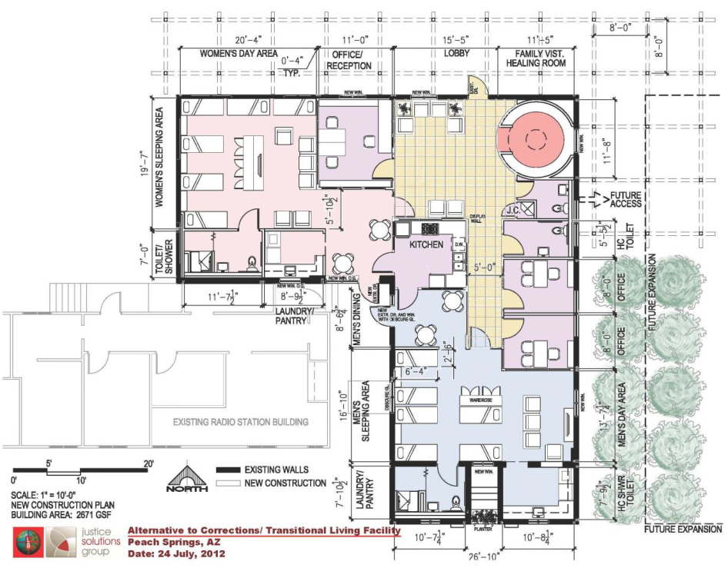
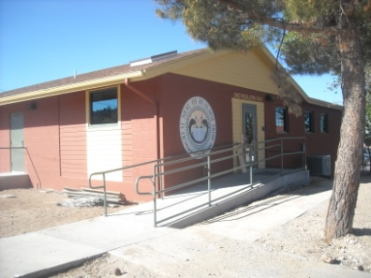
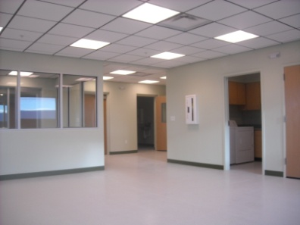
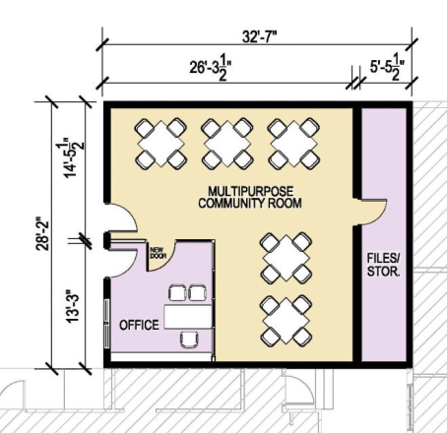
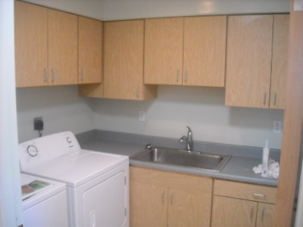
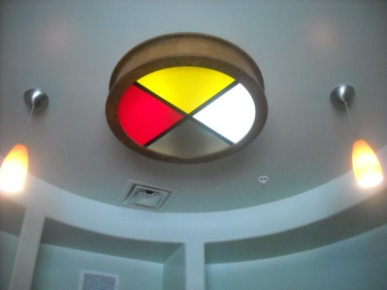
Alternative to Corrections/Transitional Living Facility
Project: A $527,761 remodel of the old IHS Clinic (3,595 sq. ft.) for up 6 men and 6 women, located south of the new Health Department building.
Status: Building is complete and awaiting occupancy.
Basement Floor Plan

Slide 8
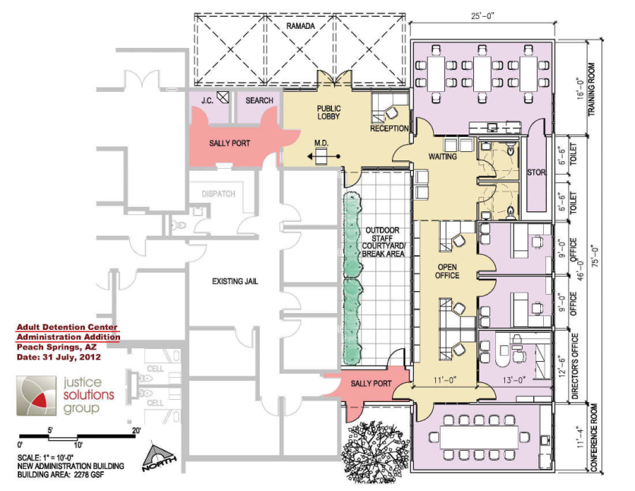
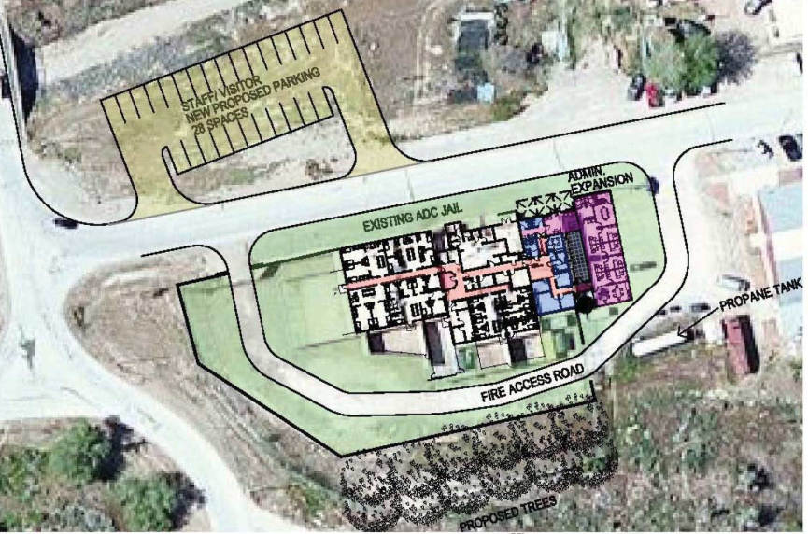
Adult Detention Center Expansion
Project: An estimated $1,159,450 remodel of the of existing facility (2,700 sq. ft.) for a new Women’s 20-bed Dormitory and Booking area plus a 2,278 sq. ft. office addition and parking lot.
Status: Architect has provided conceptual design to committee for review. Construction Project requires additional funding.
Tribe has applied for $1.1 million in funding as part of Dept of Justice grant submitted in March 2014 and awaiting award announcement in Summer 2014.

Slide 9
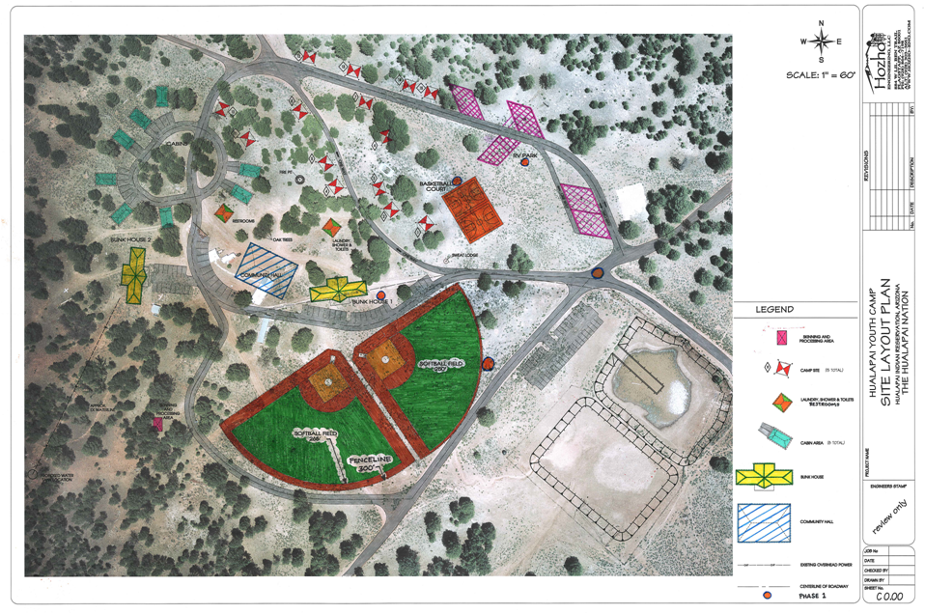
Youth Camp
Project: A new 5,967 square foot bunk house to accommodate 24 people w/ kitchen, dining room and bathrooms, a 4,000 square foot pavilion, restrooms & laundry building, cabins, RV park, open air camp sites, a 400 square foot hunter’s game preparation area, baseball field and basketball court, and infrastructure valued at $3,682,500.
Status: Infrastructure bids due on July 10, 2014. Bunk house plans being engineered. Pavilion and restroom/laundry buildings in preliminary design stage.
Front view of main entrance on east side of building
Master Plan of Youth Camp

Slide 10
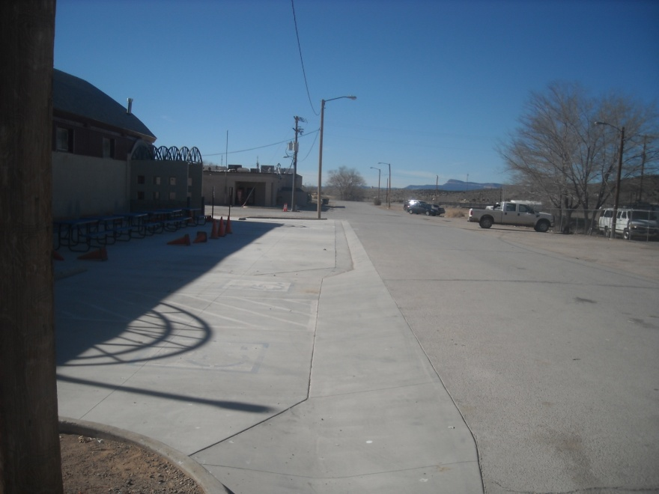
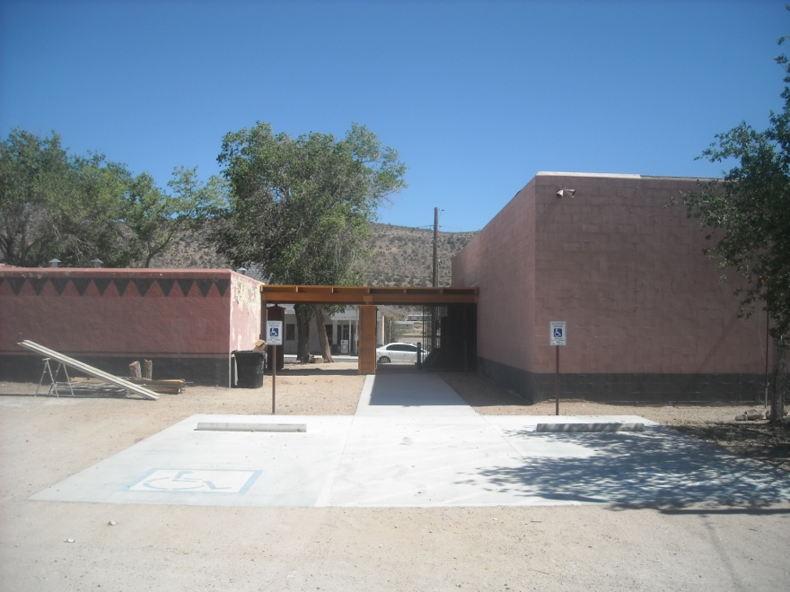
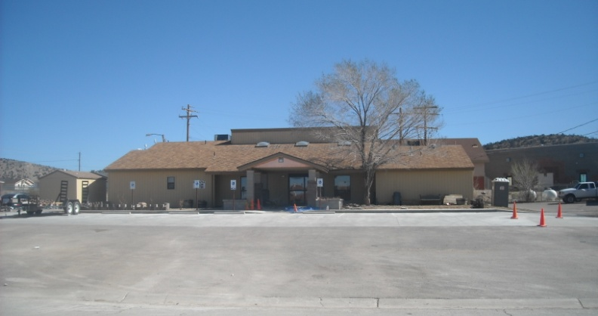
Accessibility Improvements to Public Buildings
Project: A $412,500 remodel of existing entrances at ten public buildings including the Senior Center and Gym to meet modern ADA standards.
Status: Complete.

Slide 11
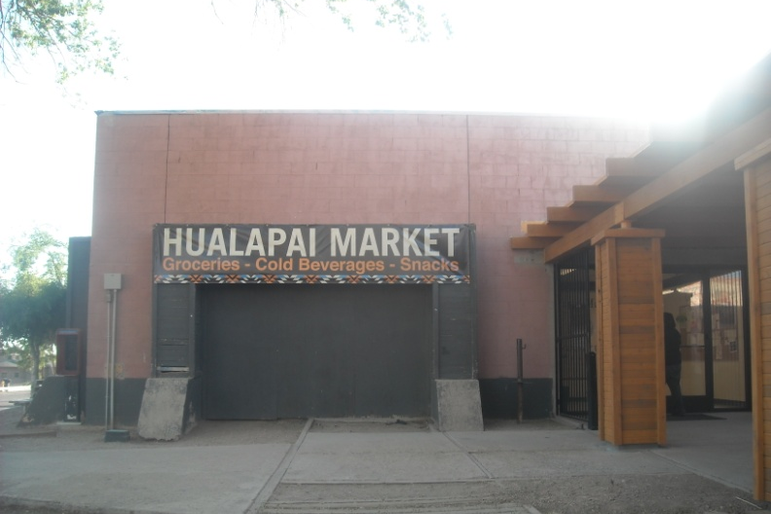
Hualapai Market and Remodel
Time Line:
  Best Market closes on May 3rd.
  On May 27th, a 1,200 sq. ft. portion of the store re-opens as Hualapai Market under management of GCRC.
  Tribal Council and GCRC vote on May 28th to expend funds to remodel the entire 5,600 sq. ft. building.
  Tribe seeks Design-Build firm to remodel market on May 29th. Proposals due on June 23rd with evaluation and contract award scheduled for early summer.
  Project estimated to take six months to design and construct after “notice to proceed” is given by Tribe.
Proposed Features and Services:
  Deli and internet café
  Butcher shop and Bakery
  Increased cold and dry storage
  New electrical, plumbing and HVAC
  New finishes throughout
  More parking
  A wider variety of food products including home-grown beef and venison and other native foods.

Slide 12
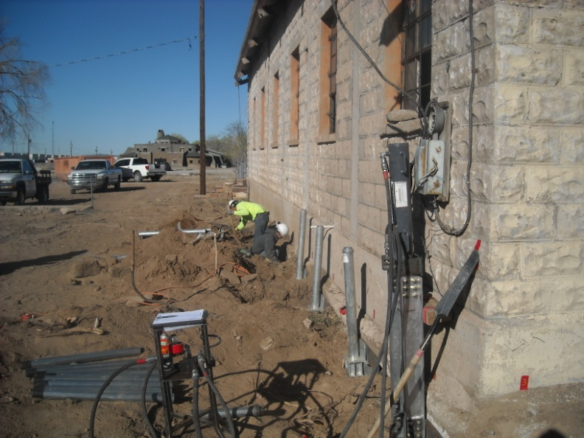
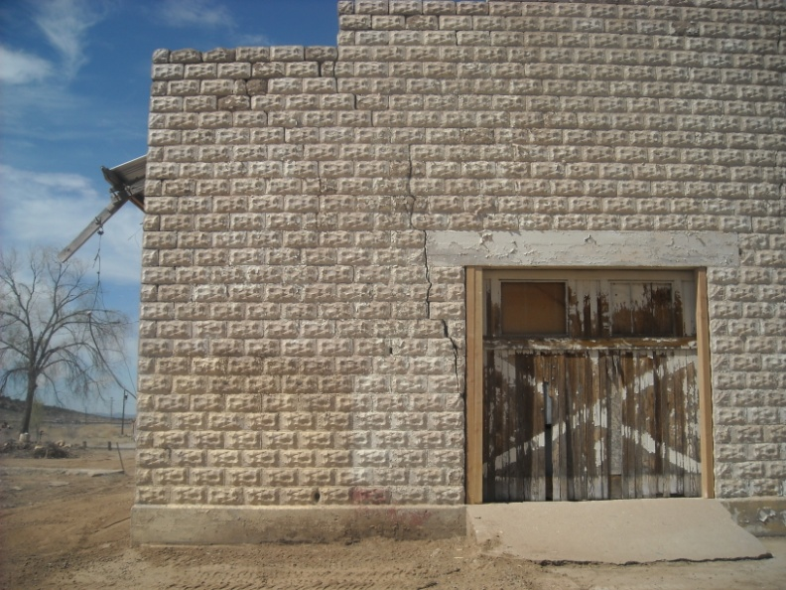
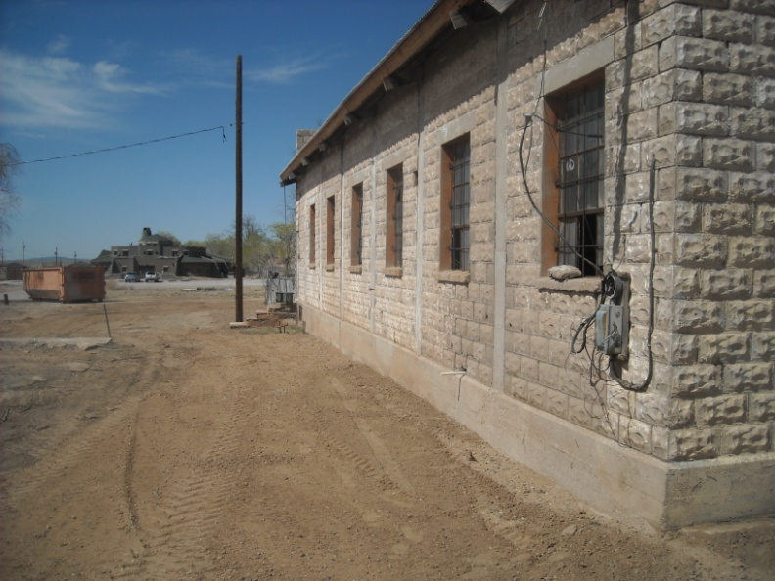
Osterman Gas Station Stabilization
Project: National Park Service has awarded a $55,000 grant to the Tribe to strengthen the walls and foundation of the historic gas station constructed in 1922.
Status: Complete.

Slide 13
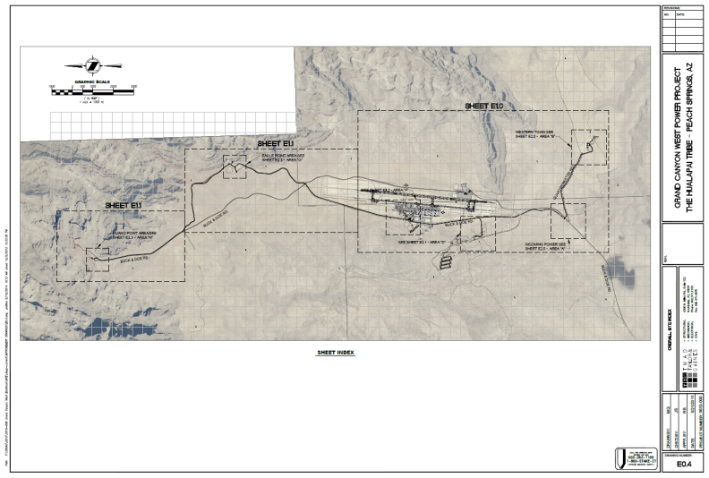
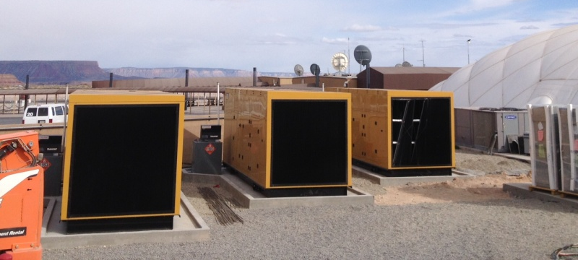
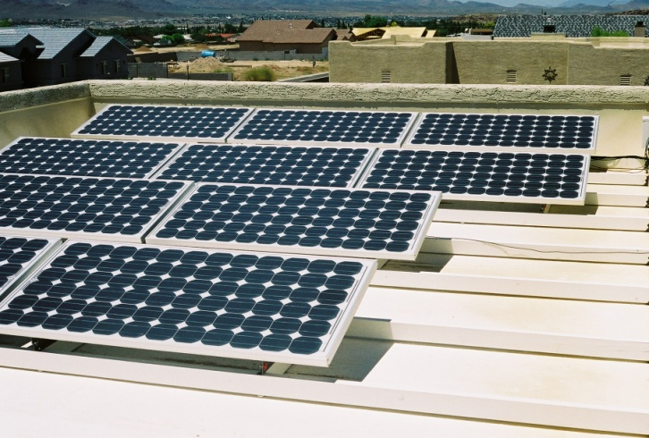
2013 – BIA - IEED – Tribal Energy Development Capacity Grant
Proposal: $100,300 allotted to:
  Establish training a program for GCRC staff to operate the mini-grid and GCW and begin an electrical apprenticeship program for solar PV installation on the Reservation.
  Provide training to Hualapai to negotiate power line rights-of-way leases
  Implement a Tribal Utility Authority
  Hire a renewable energy expert to seek a buyer of solar power produced on the Reservation.
  Prepare a energy capacity assessment report.
Progress to date:
  Application made on February 18, 2014
  Award announced on May 7, 2014
  Awaiting grant contract from BIA.

Slide 14
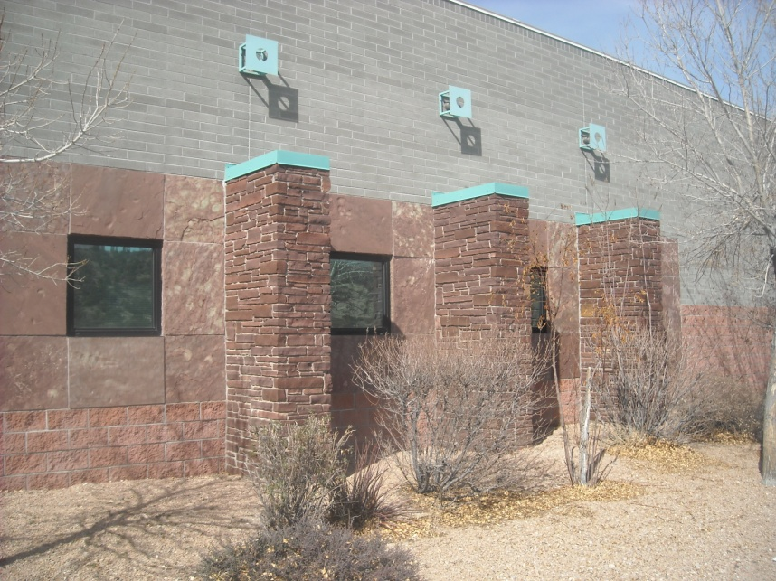
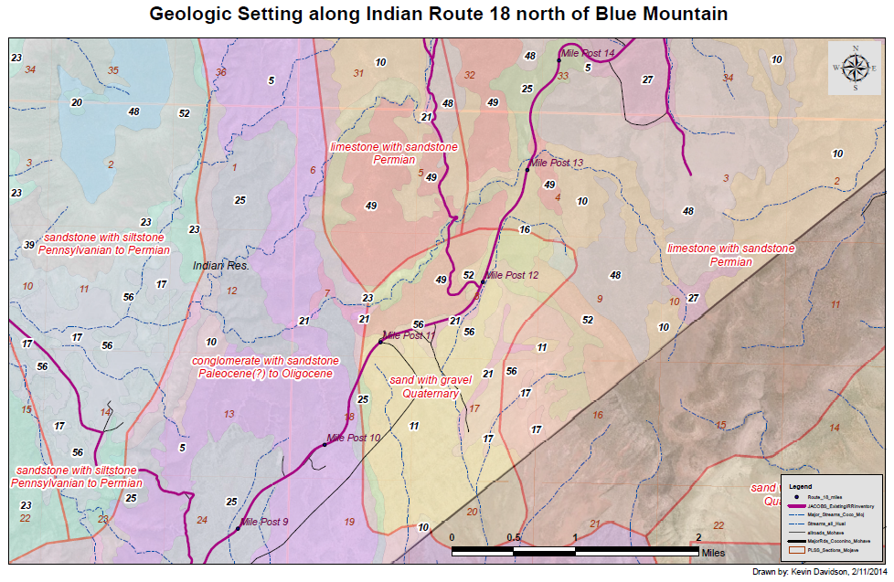
2014 - BIA Energy and Mineral Development Program- Flagstone Feasibility Study
Proposal: $28,729 to assess existing flagstone resources at existing mine on west side of Reservation and to test potential of new flagstone resources along Route 18 near mile post 10.
Progress to Date:
  Application made on February 18, 2014
  Award announced on March 6, 2014
  Awaiting grant contract from BIA.

Slide 15
Ongoing Programs
Home Site & Commercial Leases
Housing Improvement Program
Objective: Provide adequate home sites for Tribal members.
Eligibility: Lease site must be approved by Tribal Environmental Review Committee and Tribal Council.
Provides support for Court conveyances
Objective: Provide safe and sanitary housing to Tribal members
Eligibility: Based on income, age, disability and number of dependents
Options: Build new home up to $120K or remodel existing home up to $35K
Youth Recreation Program
Tribal Environmental Review Commission
Objective: Provide financial support to participate in recreation, educational and cultural activities
Eligibility: Must be a Tribal member under 25 years of age.
Objective: Review all land use and building permit applications with recommendations to Tribal Council.
Building Permits (General & Low Impact)
Gamyu Newsletter
Objective: Ensure that all building structures are built in a safe and sound manner per the Building Code.
Eligibility: Building Permits are required for structures unless specifically noted by Hualapai Environmental Review Code.
Objective: Publish community news, editorials and public notices.
Eligibility: Articles must not defame or slander private individuals.

Slide 16
Other Projects in Process
Grant Applications
Activities
2014 Indian Community Development Block Grant
CTAS funding for Adult Detention Center office expansion and establishment of Wellness Court.
ADOT “5311” for transit feasibility study grant to develop bus (fixed route or dial-a-ride) service in the Peach Springs area and provide for a “park and ride” facility and shuttle service for employees commuting to work from Kingman to Peach Springs.
Freeport-McMoRan’s Native American Partnership Fund for additional funding for Youth Camp Bunk House
Seeking proposals to remodel Osterman (Shell) gas station from private investors.
Working with Public Services Departmemt on creation of a Long Range Transportation Plan for the Hualapai Reservation.
Reviewing sites in Peach Springs suitable for solar photovoltaics to reduce electric demand from Mohave Electric Cooperative

